Slide 1
Data Analytics (CS3203N)
Lecture #7
Statistical Inference

Slide 2

Quote of the day..
Live as if you were to die tomorrow. Learn as if you were to live forever.
Mahatma Gandhi, father of nation of India

Slide 3
In this presentation…
Principle of Statistical Inference (SI)
Hypothesis in SI
Hypotheses testing procedures
Errors in hypothesis testing
Case Study 1: Coffee Sale
Case Study 2: Machine Testing
Summary of Sampling Distributions in Hypothesis Testing

Slide 4
Just a minute to mark your attendance

Slide 5




Introduction
What do you think about this piece?

Slide 6

Introduction
The primary objective of statistical analysis is to use data from a sample to make inferences about the population from which the sample was drawn.
This lecture aims to learn the basic procedures for making such inferences.
$$\overline{X}$$

Slide 7
Basic Approaches
Approach 1: Hypothesis testing
We conduct test on hypothesis.
We hypothesize that one (or more) parameter(s) has (have) some specific value(s) or relationship.
Make our decision about the parameter(s) based on one (or more) sample statistic(s)
Accuracy of the decision is expressed as the probability that the decision is incorrect.
Approach 2: Confidence interval measurement
We estimate one (or more) parameter(s) using sample statistics.
This estimation usually done in the form of an interval.
Accuracy of the decision is expressed as the level of confidence we have in the interval.

Slide 8
Hypothesis Testing
Statistical inference
Sample
Null hypothesis
Alternative hypothesis

Slide 9

Hypothesis Testing
What is Hypothesis?
“A hypothesis is an educated prediction that can be tested” (study.com).
“A hypothesis is a proposed explanation for a phenomenon” (Wikipedia).
“A hypothesis is used to define the relationship between two variables” (Oxford dictionary).
“A supposition or proposed explanation made on the basis of limited evidence as a starting point for further investigation” (Walpole).
Example 6.1: Avogadro’s Hypothesis(1811)
“The volume of a gas is directly proportional to the number of molecules of the gas.”
$$V=aN$$

Slide 10
Statistical Hypothesis
If the hypothesis is stated in terms of population parameters (such as mean and variance), the hypothesis is called statistical hypothesis.
Data from a sample (which may be an experiment) are used to test the validity of the hypothesis.
A procedure that enables us to agree (or disagree) with the statistical hypothesis is called a test of the hypothesis.
Example 6.2:
To determine whether the wages of men and women are equal.
A product in the market is of standard quality.
Whether a particular medicine is effective to cure a disease.

Slide 11
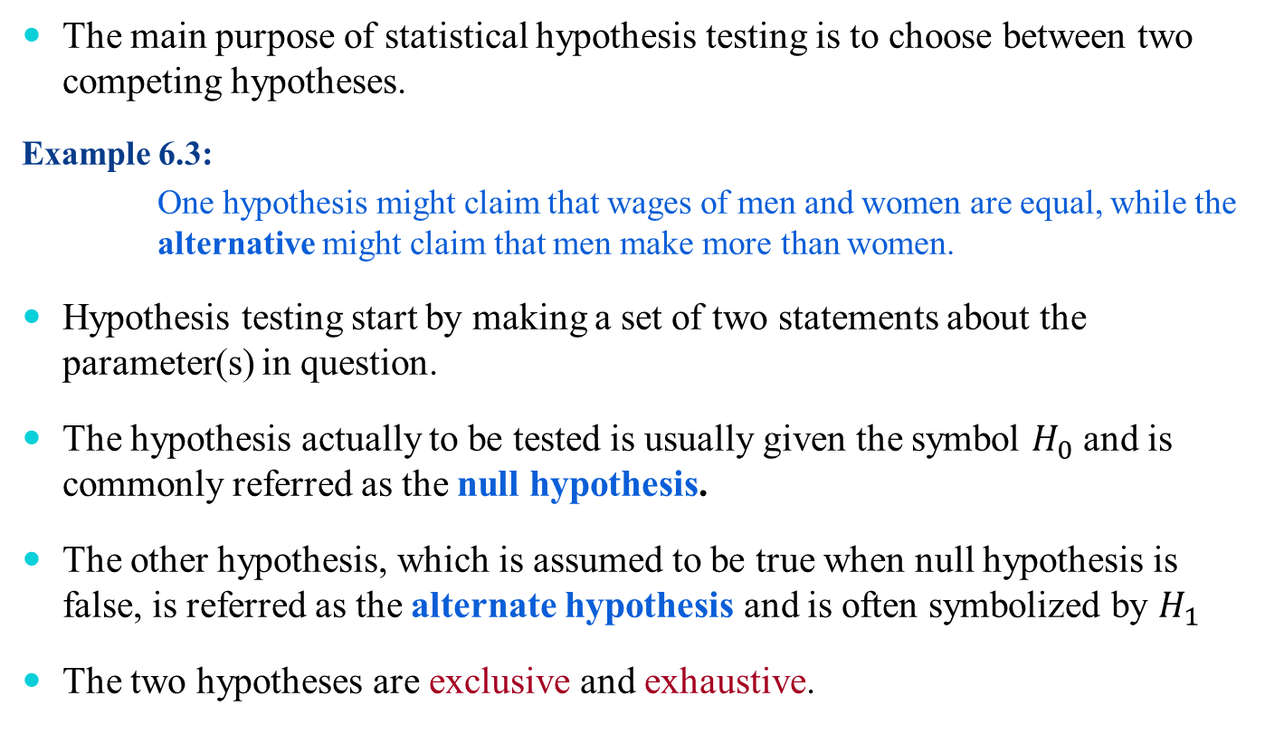
The Hypotheses
The main purpose of statistical hypothesis testing is to choose between two competing hypotheses.
Example 6.3:
One hypothesis might claim that wages of men and women are equal, while the alternative might claim that men make more than women.
Hypothesis testing start by making a set of two statements about the parameter(s) in question.
The hypothesis actually to be tested is usually given the symbol $H_{0}$ and is commonly referred as the null hypothesis.
The other hypothesis, which is assumed to be true when null hypothesis is false, is referred as the alternate hypothesis and is often symbolized by $H_{1}$
The two hypotheses are exclusive and exhaustive.

Slide 12
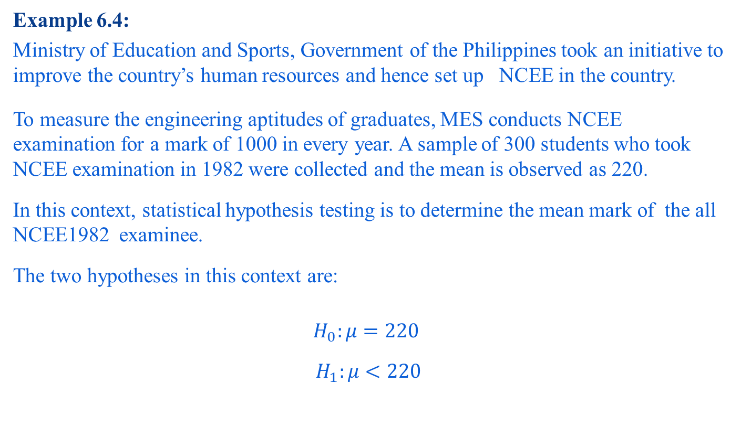
The Hypotheses
Example 6.4:
Ministry of Education and Sports, Government of the Philippines took an initiative to improve the country’s human resources and hence set up NCEE in the country.
To measure the engineering aptitudes of graduates, MES conducts NCEE examination for a mark of 1000 in every year. A sample of 300 students who took NCEE examination in 1982 were collected and the mean is observed as 220.
In this context, statistical hypothesis testing is to determine the mean mark of the all NCEE1982 examinee.
The two hypotheses in this context are:
$$H_{0}:μ=220$$
$$H_{1}:μ<220$$

Slide 13
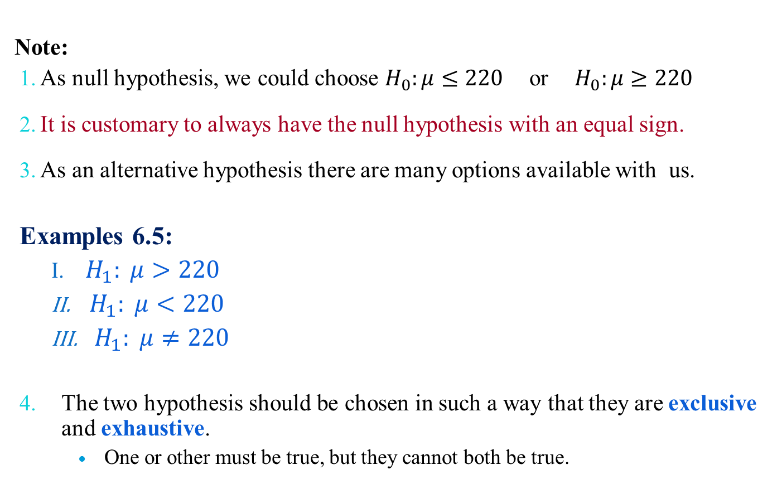
The Hypotheses
Note:
As null hypothesis, we could choose $H_{0}:μ≤220$or${ H}_{0}:μ≥220$
It is customary to always have the null hypothesis with an equal sign.
As an alternative hypothesis there are many options available with us.
Examples 6.5:
$H_{1}: μ>220$
${ H}_{1}: μ<220$
${ H}_{1}: μ≠220$
The two hypothesis should be chosen in such a way that they are exclusive and exhaustive.
One or other must be true, but they cannot both be true.

Slide 14
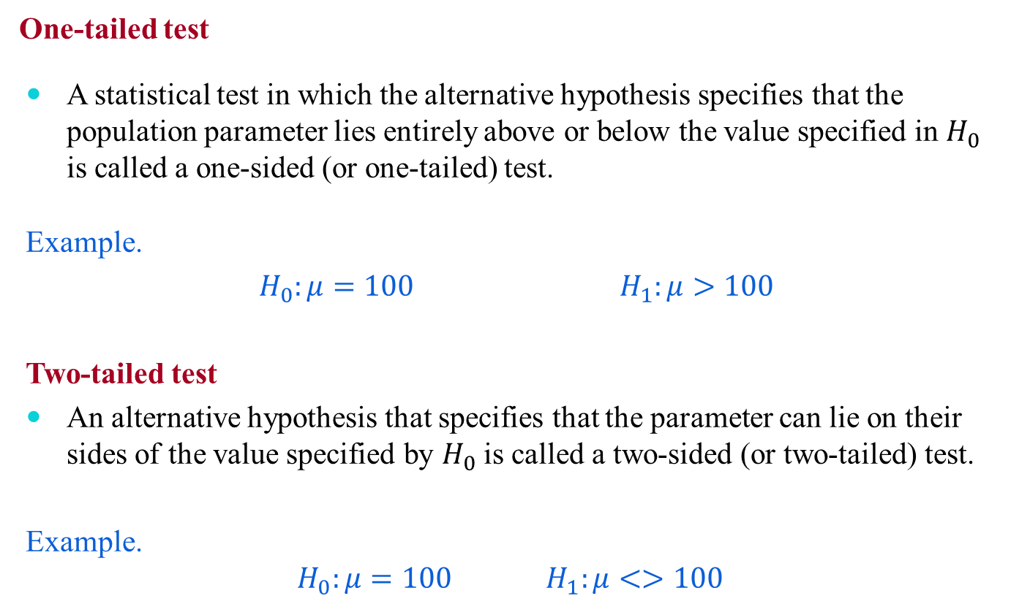
The Hypotheses
One-tailed test
A statistical test in which the alternative hypothesis specifies that the population parameter lies entirely above or below the value specified in $H_{0}$ is called a one-sided (or one-tailed) test.
Example.
$H_{0}:μ=100$ $H_{1}:μ>100$
Two-tailed test
An alternative hypothesis that specifies that the parameter can lie on their sides of the value specified by $H_{0}$ is called a two-sided (or two-tailed) test.
Example.
$$H_{0}:μ=100 H_{1}:μ<>100$$

Slide 15


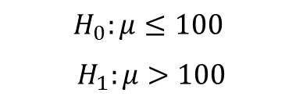
The Hypotheses
Note:
In fact, a 1-tailed test such as:
is same as
In essence, $μ>100,$ it does not imply that $μ>80,μ>90$, etc.
$$H_{0}:μ=100$$
$$H_{1}:μ>100$$
$$H_{0}:μ≤100$$
$$H_{1}:μ>100$$

Slide 16
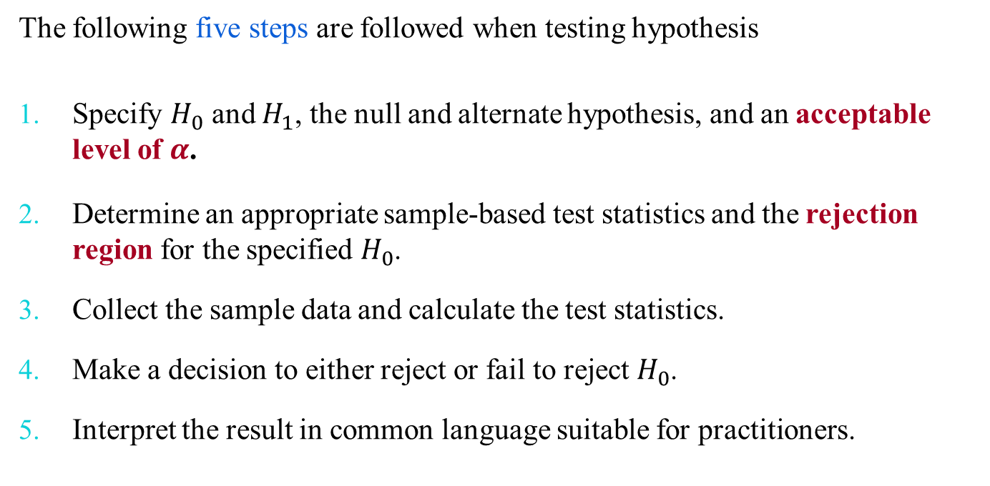
Hypothesis Testing Procedures
The following five steps are followed when testing hypothesis
Specify $H_{0}$ and $H_{1}$, the null and alternate hypothesis, and an acceptable level of $α$.
Determine an appropriate sample-based test statistics and the rejection region for the specified $H_{0}$.
Collect the sample data and calculate the test statistics.
Make a decision to either reject or fail to reject $H_{0}$.
Interpret the result in common language suitable for practitioners.

Slide 17
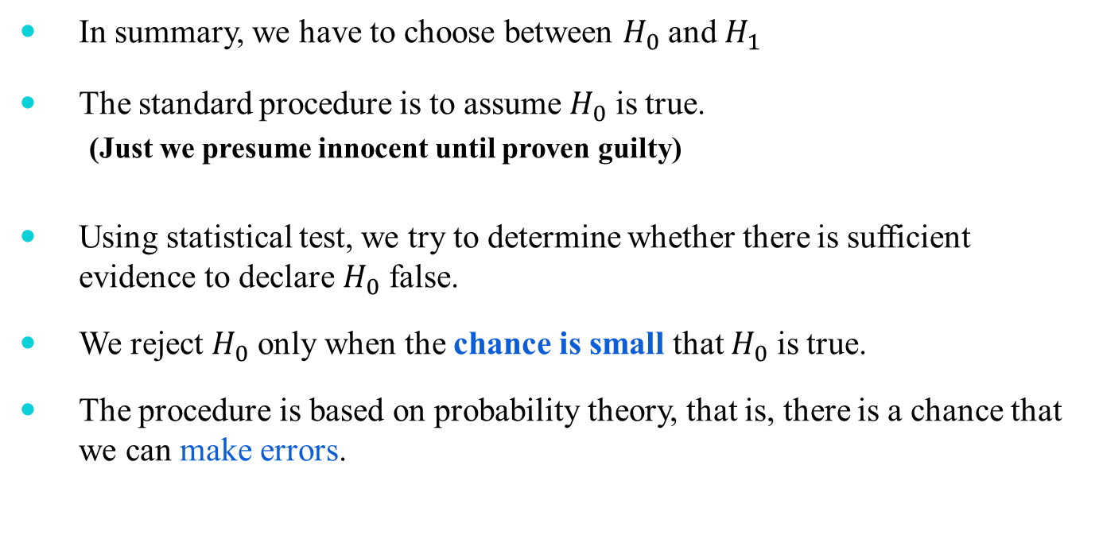
Hypothesis Testing Procedure
In summary, we have to choose between $H_{0}$ and $H_{1}$
The standard procedure is to assume $H_{0}$ is true.
(Just we presume innocent until proven guilty)
Using statistical test, we try to determine whether there is sufficient evidence to declare $H_{0}$ false.
We reject $H_{0}$ only when the chance is small that $H_{0}$ is true.
The procedure is based on probability theory, that is, there is a chance that we can make errors.

Slide 18
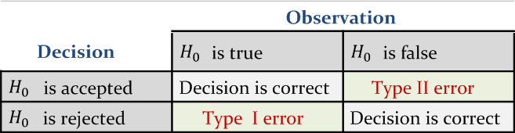
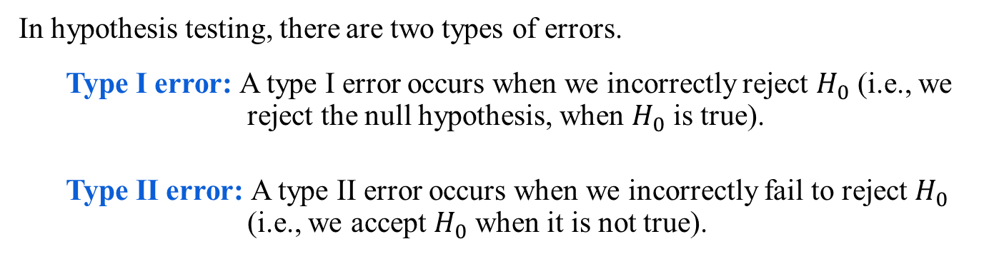
Errors in Hypothesis Testing
In hypothesis testing, there are two types of errors.
Type I error: A type I error occurs when we incorrectly reject $H_{0}$ (i.e., we reject the null hypothesis, when $H_{0}$ is true).
Type II error: A type II error occurs when we incorrectly fail to reject $H_{0}$ (i.e., we accept $H_{0}$ when it is not true).

Slide 19
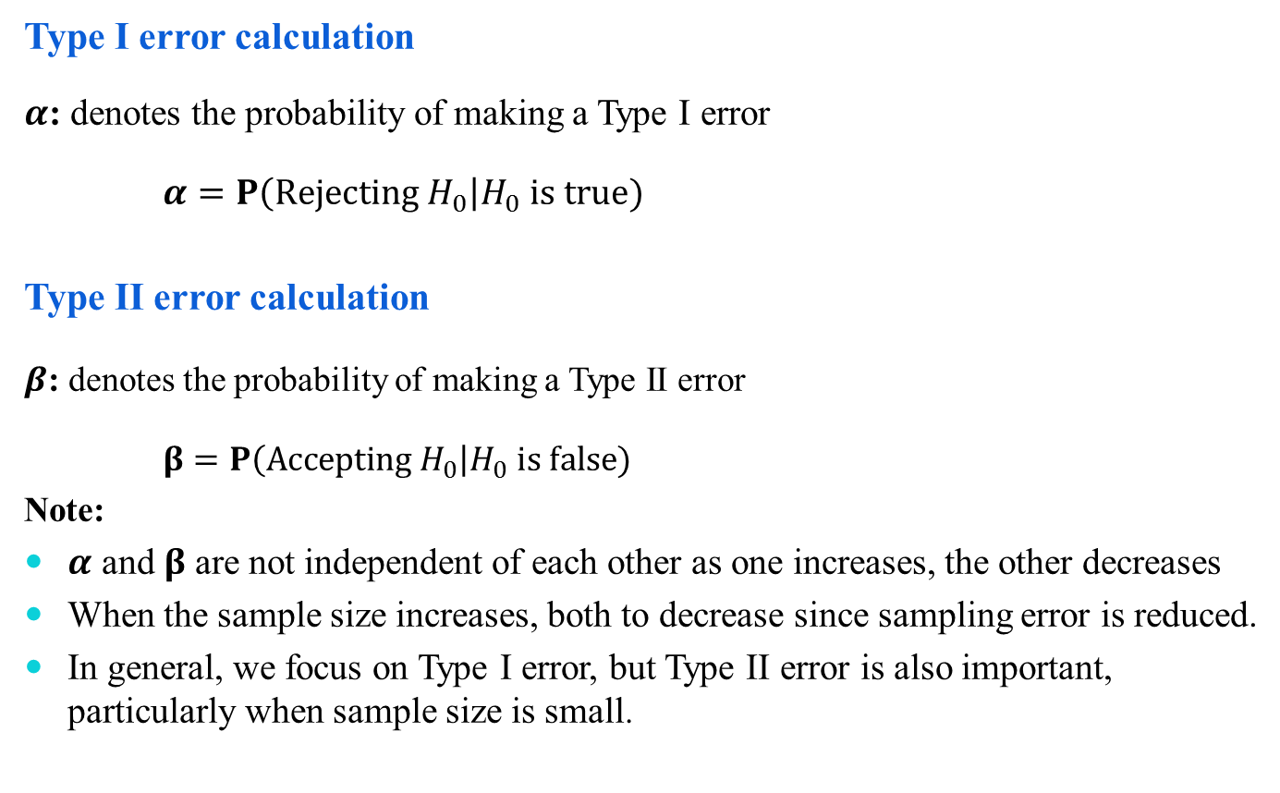
Probabilities of Making Errors
Type I error calculation
$α$: denotes the probability of making a Type I error
$α=P\left(Rejecting H_{0}\right|H_{0} is true)$
Type II error calculation
$β$: denotes the probability of making a Type II error
$β=P\left(Accepting H_{0}\right|H_{0} is false)$
Note:
$α$ and $β$ are not independent of each other as one increases, the other decreases
When the sample size increases, both to decrease since sampling error is reduced.
In general, we focus on Type I error, but Type II error is also important, particularly when sample size is small.

Slide 20

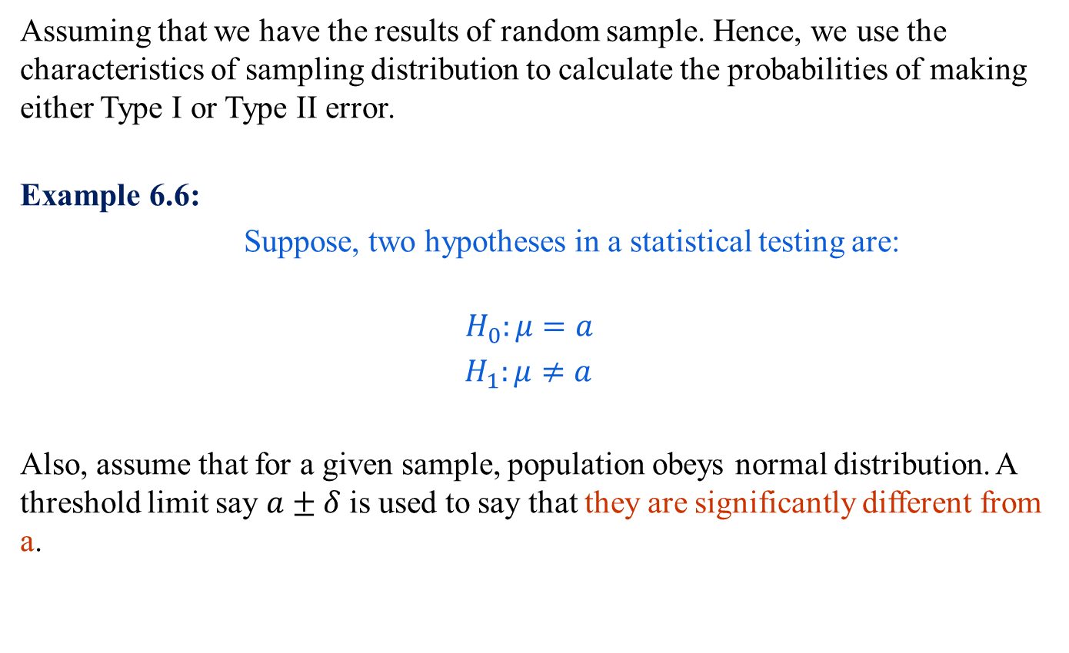
Calculating $α$
Assuming that we have the results of random sample. Hence, we use the characteristics of sampling distribution to calculate the probabilities of making either Type I or Type II error.
Example 6.6:
Suppose, two hypotheses in a statistical testing are:
$$H_{0}:μ=a$$
$H_{1}:μ≠a$
Also, assume that for a given sample, population obeys normal distribution. A threshold limit say $a±δ$ is used to say that they are significantly different from a.

Slide 21

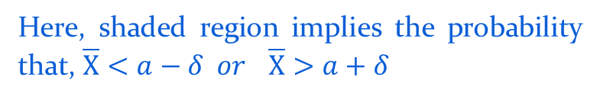
Calculating $α$
Thus the null hypothesis is to be rejected if the mean value is less than $a−δ$ or greater than $a+δ$.
If $\overline{X}$ denotes the sample mean, then the Type I error is
$$α=P(\overline{X}<a−δ or \overline{X}>a+δ, when μ=a , i.e.,{ H}_{0} is true)$$
Here, shaded region implies the probability that, $\overline{X}<a−δ or$ $\overline{X}>a+δ$

Slide 22

The Rejection Region
The rejection region comprises of value of the test statistics for which
The probability when the null hypothesis is true is less than or equal to the specified $α$.
Probability when $H_{1 }$is true are greater than they are under $H_{0}$.

Slide 23

Two-Tailed Test
For two-tailed hypothesis test, hypotheses take the form
$$H_{0}:μ=μ_{H_{0}}$$
$$H_{1}:μ≠μ_{H_{0}}$$
In other words, to reject a null hypothesis, sample mean $μ>μ_{H_{0}}$ or $μ<μ_{H_{0}}$ under a given $α$.
Thus, in a two-tailed test, there are two rejection regions (also known as critical region), one on each tail of the sampling distribution curve.

Slide 24
Two-Tailed Test
Acceptance and rejection regions in case of a two-tailed test with 5% significance level.

Slide 25



One-Tailed Test
A one-tailed test would be used when we are to test, say, whether the population mean is either lower or higher than the hypothesis test value.
Symbolically,
$$H_{0}:μ=μ_{H_{0}}$$
${ H}_{1}:μ<μ_{H_{0}} [or μ>μ_{H_{0}}]$
Wherein there is one rejection region only on the left-tail (or right-tail).
$$Left−tailed test$$
$$Right−tailed test$$

Slide 26

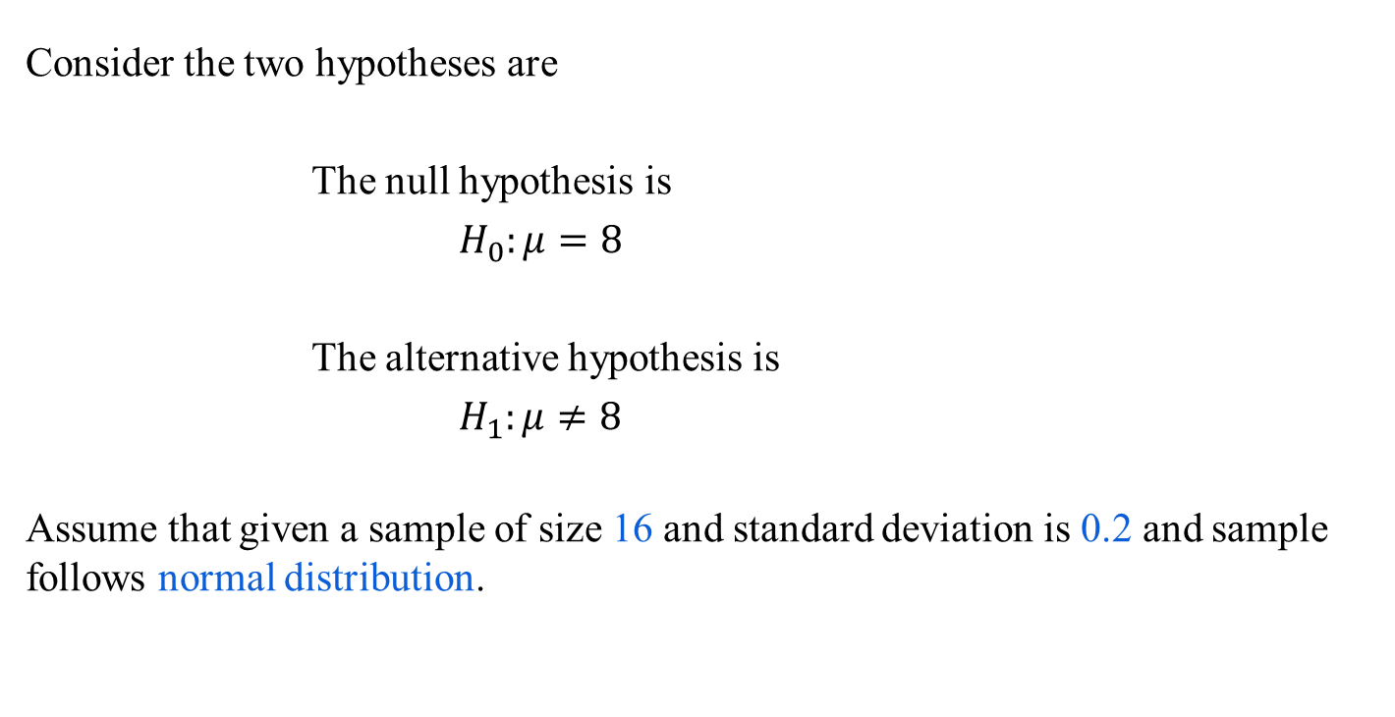
Example 6.7: Calculating $α$
Consider the two hypotheses are
The null hypothesis is
$H_{0}:μ=8$
The alternative hypothesis is
$H_{1}:μ≠8$
Assume that given a sample of size 16 and standard deviation is 0.2 and sample follows normal distribution.

Slide 27
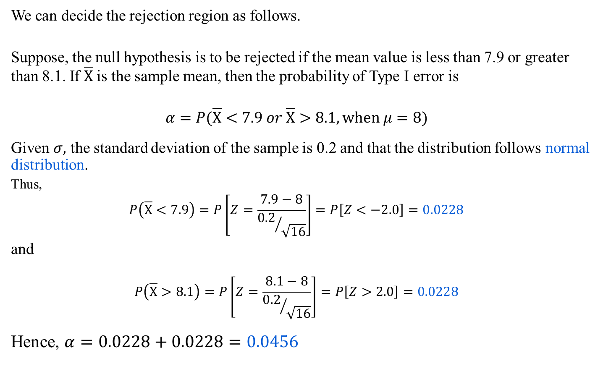
Example 6.7: Calculating $α$
We can decide the rejection region as follows.
Suppose, the null hypothesis is to be rejected if the mean value is less than 7.9 or greater than 8.1. If $\overline{X}$ is the sample mean, then the probability of Type I error is
$$α=P(\overline{X}<7.9 or \overline{X}>8.1, when μ=8)$$
Given $σ,$ the standard deviation of the sample is 0.2 and that the distribution follows normal distribution.
Thus,
$$P\left(\overline{X}<7.9\right)=P\left[Z=\frac{7.9−8}{{0.2}/{\sqrt{16}}}\right]=P\left[Z<−2.0\right]=0.0228$$
and
$$P\left(\overline{X}>8.1\right)=P\left[Z=\frac{8.1−8}{{0.2}/{\sqrt{16}}}\right]=P\left[Z>2.0\right]=0.0228$$
Hence, $α=0.0228+0.0228=0.0456$

Slide 28

Example 6.8: Calculating $α$ and $β$
There are two identically appearing boxes of chocolates. Box A contains 60 red and 40 black chocolates whereas box B contains 40 red and 60 black chocolates. There is no label on the either box. One box is placed on the table. We are to test the hypothesis that “Box B is on the table”.
To test the hypothesis an experiment is planned, which is as follows:
Draw at random five chocolates from the box.
We replace each chocolates before selecting a new one.
The number of red chocolates in an experiment is considered as the sample statistics.
Note: Since each draw is independent to each other, we can assume the sample distribution
follows binomial probability distribution.

Slide 29


Example 6.8: Calculating $α$
Let us express the population parameter as $p=the number of red chocolates in Box B.$
The hypotheses of the problem can be stated as:
$H_{0}:p=0.4$ // Box B is on the table
${ H}_{1}:p=0.6$ // Box A is on the table
Calculating $α:$
In this example, the null hypothesis ${(H}_{0})$ specifies that the probability of drawing a red chocolate is $0.4$. This means that, lower proportion of red chocolates in observations $(i.e., sample)$ favors the null hypothesis. In other words, drawing all red chocolates provides sufficient evidence to reject the null hypothesis. Then, the probability of making a $Type I$ error is the probability of getting five red chocolates in a sample of five from Box B. That is,
$$α=P\left(X=5 when p=0.4\right)$$
Using the binomial distribution
$=\frac{n!}{x!\left(n−x\right)!}p^{x}{(1−p)}^{n−x}$ $where n=5, x=5$
$$={(0.4)}^{5}=0.01024$$
Thus, the probability of rejecting a true null hypothesis is $≈0.01.$ That is, there is approximately $1 in 100$chance that the box B will be mislabeled as box A.

Slide 30


Example 6.8: Calculating $β$
The $Type II$ error occurs if we fail to reject the null hypothesis when it is not true. For the current illustration, such a situation occurs, if Box A is on the table but we did not get the five red chocolates required to reject the hypothesis that Box B is on the table.
The probability of $Type II$ error is then the probability of getting four or fewer red chocolates in a sample of five from Box A.
That is,
$$β=P\left(X≤4 when p=0.6\right)$$
Using the probability rule:
$$P\left(X≤4\right)+P(X=5)=1$$
That is, $P\left(X≤4\right)=1−P(X=5)$
Now, $P(X=5)={(0.6)}^{5}$
Hence, $β=1−{(0.6)}^{5}$
$$=1−0.07776=0.92224$$
That is, the probability of making $Type II$ error is over $92\%$. This means that, if Box A is on the table, the probability that we will be unable to detect it is $0.92$.

Slide 31

Case Study 1: Coffee Sale
A coffee vendor nearby Kharagpur railway station has been having average sales of 500 cups per day. Because of the development of a bus stand nearby, it expects to increase its sales. During the first 12 days, after the inauguration of the bus stand, the daily sales were as under:
550 570 490 615 505 580 570 460 600 580 530 526
On the basis of this sample information, can we conclude that the sales of coffee have increased?
Consider 5% level of confidence.

Slide 32

Hypothesis Testing : 5 Steps
The following five steps are followed when testing hypothesis
Specify $H_{0}$ and $H_{1}$, the null and alternate hypothesis, and an acceptable level of $α$.
Determine an appropriate sample-based test statistics and the rejection region for the specified $H_{0}$.
Collect the sample data and calculate the test statistics.
Make a decision to either reject or fail to reject $H_{0}$.
Interpret the result in common language suitable for practitioner.

Slide 33
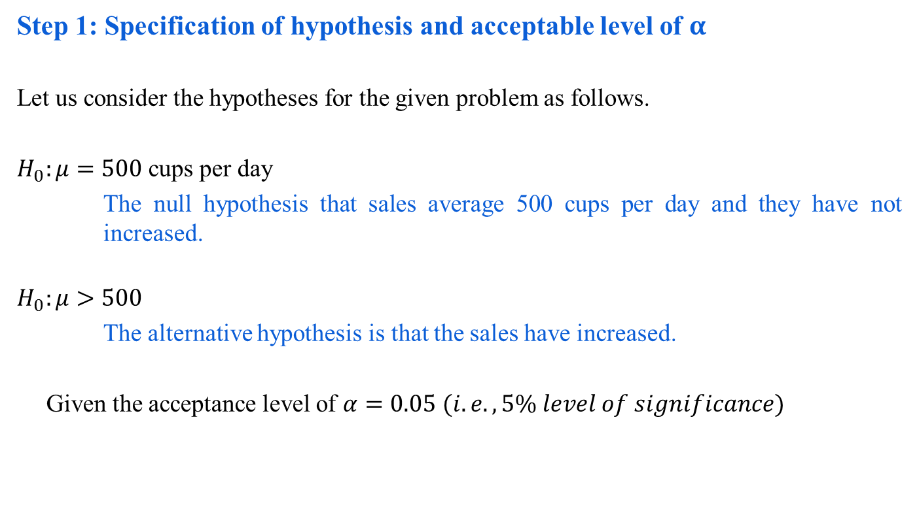
Case Study 1: Step 1
Step 1: Specification of hypothesis and acceptable level of $α$
Let us consider the hypotheses for the given problem as follows.
$H_{0}:μ=500$ cups per day
The null hypothesis that sales average 500 cups per day and they have not increased.
$$H_{0}:μ>500$$
The alternative hypothesis is that the sales have increased.
Given the acceptance level of $α=0.05$ $(i.e., 5\% level of significance)$

Slide 34
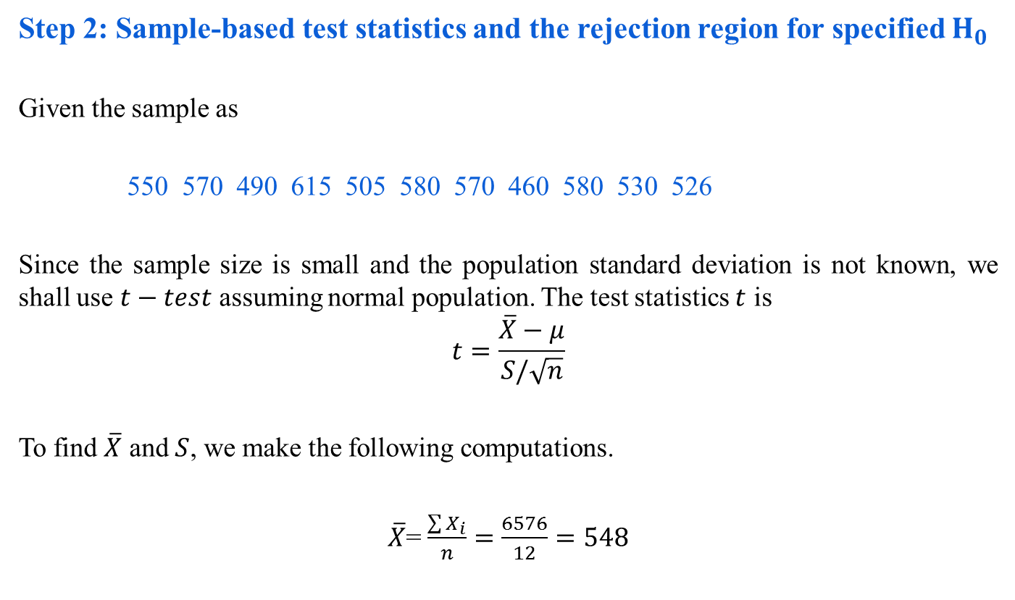
Case Study 1: Step 2
Step 2: Sample-based test statistics and the rejection region for specified $H_{0}$
Given the sample as
550 570 490 615 505 580 570 460 580 530 526
Since the sample size is small and the population standard deviation is not known, we shall use $t−test$ assuming normal population. The test statistics $t$ is
$$t=\frac{\overline{X}−μ}{S/\sqrt{n}}$$
To find $\overline{X}$ and $S$, we make the following computations.
$\overline{X}$=$\frac{\sum{X_{i}}}{n}=\frac{6576}{12}=548$

Slide 35
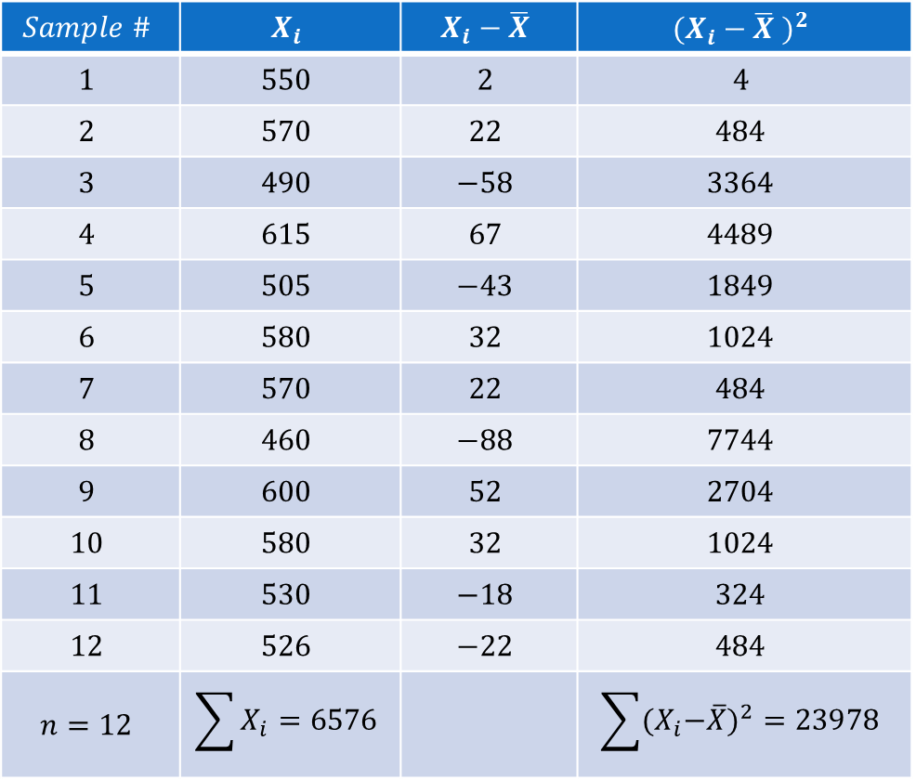
Case Study 1: Step 2
$$Sample \#$$ | $$X_{i}$$ | $$X_{i}−\overline{X}$$ | $${(X_{i}−\overline{X} )}^{2}$$
$$1$$ | $$550$$ | $$2$$ | $$4$$
$$2$$ | $$570$$ | $$22$$ | $$484$$
$$3$$ | $$490$$ | $$−58$$ | $$3364$$
$$4$$ | $$615$$ | $$67$$ | $$4489$$
$$5$$ | $$505$$ | $$−43$$ | $$1849$$
$$6$$ | $$580$$ | $$32$$ | $$1024$$
$$7$$ | $$570$$ | $$22$$ | $$484$$
$$8$$ | $$460$$ | $$−88$$ | $$7744$$
$$9$$ | $$600$$ | $$52$$ | $$2704$$
$$10$$ | $$580$$ | $$32$$ | $$1024$$
$$11$$ | $$530$$ | $$−18$$ | $$324$$
$$12$$ | $$526$$ | $$−22$$ | $$484$$
$$n=12$$ | $$\sum{X_{i}=6576}$$ |  | $$\sum{{{(X}_{i}−\overline{X})}^{2}=23978}$$

Slide 36

Case Study 1: Step 2
$$S=\sqrt{\frac{{\sum{(X_{i}−\overline{X})}}^{2}}{n−1}}=\sqrt{\frac{23978}{12−1}}=46.68$$
Hence, $t=\frac{\overline{X}−μ }{S/\sqrt{n}}=\frac{48}{46.68/\sqrt{12}}=\frac{48}{13.49}=3.558$
Note:
Statistical table for t-distributions gives a t-value given n, the degrees of freedom and $α$, the level of significance and vice-versa.

Slide 37

Case Study 1: Step 3
Step 3: Collect the sample data and calculate the test statistics
$$Degree of freedom=n−1=12−1=11$$
As $H_{1}$ is one-tailed, we shall determine the rejection region applying one-tailed in the right tail because $H_{1}$ is more than type ) at $5\%$ level of significance.

Slide 38

Case Study 1: Step 3
Step 3: Collect the sample data and calculate the test statistics
$$Degree of freedom=n−1=12−1=11$$
As $H_{1}$ is one-tailed, we shall determine the rejection region applying one-tailed in the right tail because $H_{1}$ is more than type ) at $5\%$ level of significance.
Using table of $t−distribution$ for 11 degrees of freedom and with $5\%$ level of significance,
$$R:t>1.796$$

Slide 39

Case Study 1: Step 4
Step 4: Make a decision to either reject or fail to reject H₀
The observed value of $t=3.558$ which is in the rejection region and thus $H_{0}$ is rejected at $5\%$ level of significance.

Slide 40
Case Study 1: Step 5
Step 5: Final comment and interpret the result
We can conclude that the sample data indicate that coffee sales have increased.

Slide 41

Case Study 2: Machine Testing
A medicine production company packages medicine in a tube of 8 ml. In maintaining the control of the amount of medicine in tubes, they use a machine. To monitor this control a sample of 16 tubes is taken from the production line at random time interval and their contents are measured precisely. The mean amount of medicine in these 16 tubes will be used to test the hypothesis that the machine is indeed working properly.

Slide 42
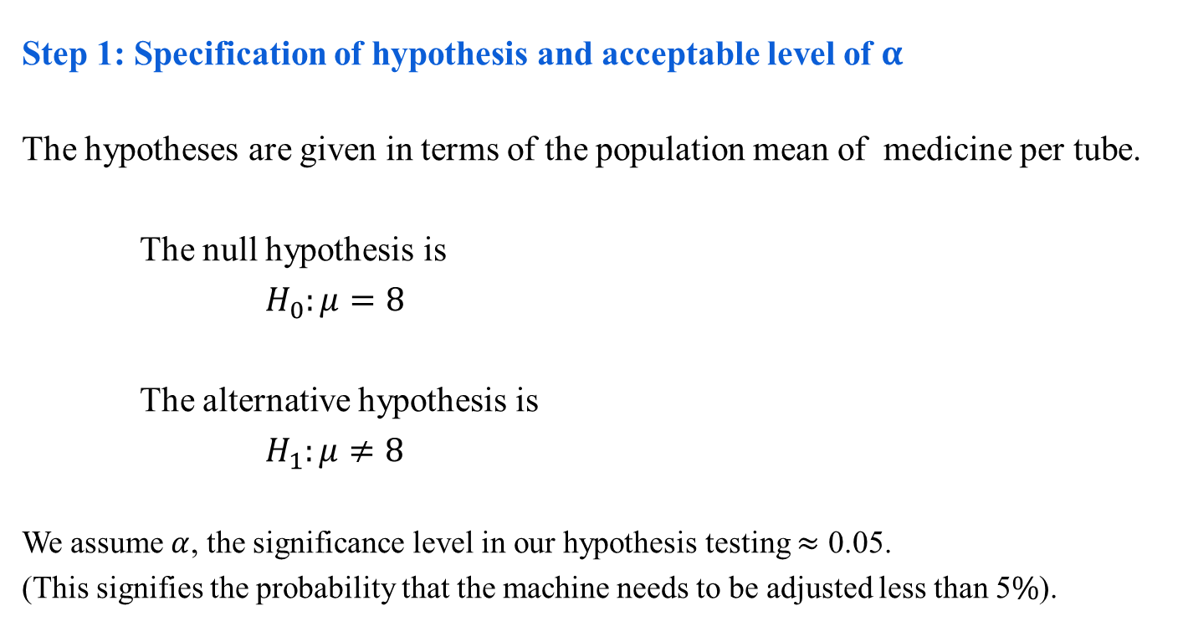
Case Study 2: Step 1
Step 1: Specification of hypothesis and acceptable level of $α$
The hypotheses are given in terms of the population mean of medicine per tube.
The null hypothesis is
$H_{0}:μ=8$
The alternative hypothesis is
$H_{1}:μ≠8$
We assume $α$, the significance level in our hypothesis testing $≈$ 0.05.
(This signifies the probability that the machine needs to be adjusted less than 5$\%$).

Slide 43

Case Study 2: Step 2
Step 2: Sample-based test statistics and the rejection region for specified $H_{0}$
Rejection region: G$iven α=0.05$, which gives $\left|Z\right|>1.96$ (obtained from standard normal calculation for $n\left(Z:0,1\right)=0.025 for a rejection region with$ two-tailed test).

Slide 44

Case Study 2: Step 3
Step 3: Collect the sample data and calculate the test statistics
Sample results: $n=16$, $\overline{x}=7.89$, $σ=0.2$
With the sample, the test statistics is
$Z=\frac{7.89−8}{{0.2}/{\sqrt{16}}}=−2.20$
Hence, $\left|Z\right|=2.20$

Slide 45

Case Study 2: Step 4
Step 4: Make a decision to either reject or fail to reject H₀
Since $Z>1.96$, we reject $H_{0}$

Slide 46

Case Study 2: Step 5
Step 5: Final comment and interpret the result
We conclude $μ≠8$ and recommend that the machine be adjusted.

Slide 47
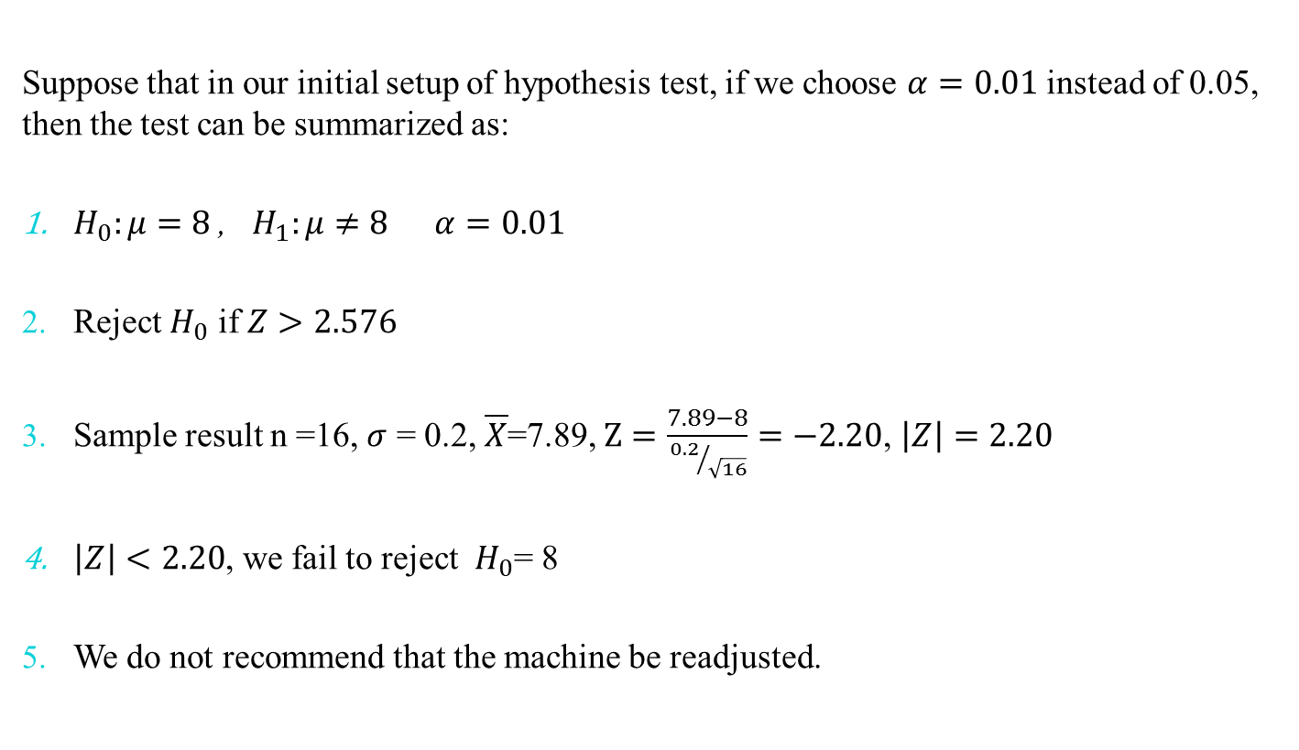
Case Study 2: Alternative Test
Suppose that in our initial setup of hypothesis test, if we choose $α=0.01$ instead of 0.05, then the test can be summarized as:
$H_{0}:μ=8$, $H_{1}:μ≠8$ $α=0.01$
Reject $H_{0}$ if $Z>2.576$
Sample result n =16, $σ$ = 0.2, $\overline{X}$=7.89, $Z=\frac{7.89−8}{{0.2}/{\sqrt{16}}}=−2.20$, $\left|Z\right|=2.20$
$\left|Z\right|<2.20$, we fail to reject $H_{0}$= 8
We do not recommend that the machine be readjusted.

Slide 48
Hypothesis Testing Strategies
The hypothesis testing determines the validity of an assumption (technically described as null hypothesis), with a view to choose between two conflicting hypothesis about the value of a population parameter.
There are two types of tests of hypotheses
Non-parametric tests (also called distribution-free test of hypotheses)
Parametric tests (also called standard test of hypotheses).

Slide 49
Parametric Tests : Applications
Usually assume certain properties of the population from which we draw samples.
Observation come from a normal population
Sample size is small
Population parameters like mean, variance, etc. are hold good.
Requires measurement equivalent to interval scaled data.

Slide 50

Parametric Tests
Important Parametric Tests
The widely used sampling distribution for parametric tests are
$Z−test$
$t−test$
$χ^{2}−test$
$F−test$
Note:
All these tests are based on the assumption of normality (i.e., the source of data is considered to be normally distributed).

Slide 51

Parametric Tests : Z-test
$Z−test$: This is most frequently test in statistical analysis.
It is based on the normal probability distribution.
Used for judging the significance of several statistical measures particularly the mean.
It is used even when $binomial distribution$or $t−distribution$ is applicable with a condition that such a distribution tends to normal distribution when n becomes large.
Typically it is used for comparing the mean of a sample to some hypothesized mean for the population in case of large sample, or when population variance is known.

Slide 52

Parametric Tests : t-test
$t−test$: It is based on the t-distribution.
It is considered an appropriate test for judging the significance of a sample mean or for judging the significance of difference between the means of two samples in case of
small sample(s)
population variance is not known (in this case, we use the variance of the sample as an estimate of the population variance)

Slide 53


Parametric Tests : $χ^{2}$-test
$χ^{2}−test$: It is based on Chi-squared distribution.
It is used for comparing a sample variance to a theoretical population variance.

Slide 54


Parametric Tests : $F$-test
$F−test$: It is based on F-distribution.
It is used to compare the variance of two independent samples.
This test is also used in the context of analysis of variance (ANOVA) for judging the significance of more than two sample means.

Slide 55

Hypothesis Testing : Assumptions
Case 1: Normal population, population infinite, sample size may be large or small, variance of the population is known.
$$z=\frac{\overline{X}−μ_{H_{0}}}{σ/\sqrt{n}}$$
Case 2: Population normal, population finite, sample size may large or small………variance is known.
$$z=\frac{\overline{X}−μ_{H_{0}}}{σ/\sqrt{n}[\sqrt{(N−n)/(N−1)}]}$$
Case 3: Population normal, population infinite, sample size is small and variance of the population is unknown.
$t=\frac{\overline{X}−μ_{H_{0}}}{S/\sqrt{n}}$ $with degree of freedom=(n−1)$
and $s=\sqrt{\frac{\sum{{(X_{i}−\overline{X})}^{2}}}{(n−1)}}$

Slide 56

Hypothesis Testing
Case 4: Population finite
$t=\frac{\overline{X}−μ_{H_{0}}}{σ/\sqrt{n}[\sqrt{(N−n)/(N−1)}]}$ $with degree of freedom=(n−1)$
Note: If variance of population $\left(σ\right)$ is known, replace $S$ by $σ$. Population normal, population infinite, sample size is small and variance of the population is unknown.

Slide 57
Hypothesis Testing : Non-Parametric Test
Non-Parametric tests
Does not under any assumption
Assumes only nominal or ordinal data
Note: Non-parametric tests need entire population (or very large sample size)

Slide 58
Reference
The detail material related to this lecture can be found in
Probability and Statistics for Engineers and Scientists (8th Ed.) by Ronald E. Walpole, Sharon L. Myers, Keying Ye (Pearson), 2013.

Slide 59
Any question?
You may post your question(s) at the “Discussion Forum” maintained in the course Web page!

Slide 60
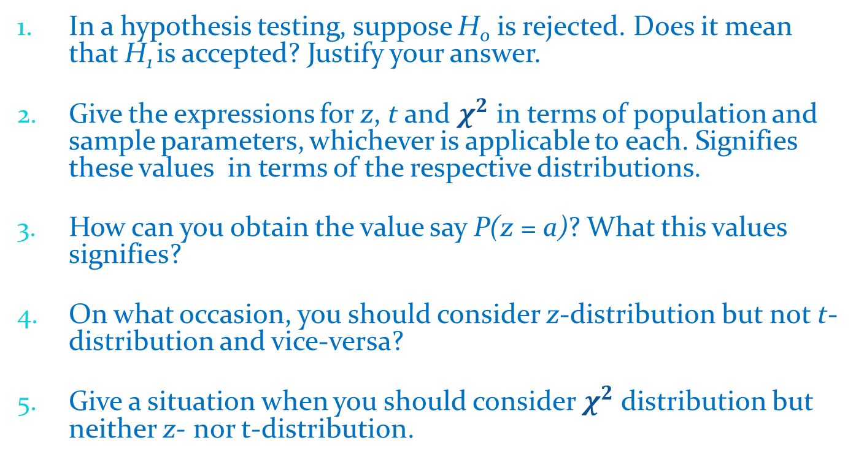
Questions of the day…
In a hypothesis testing, suppose H₀ is rejected. Does it mean that H₁ is accepted? Justify your answer.
Give the expressions for z, t and $χ^{2}$ in terms of population and sample parameters, whichever is applicable to each. Signifies these values in terms of the respective distributions.
How can you obtain the value say P(z = a)? What this values signifies?
On what occasion, you should consider z-distribution but not t-distribution and vice-versa?
Give a situation when you should consider $χ^{2}$ distribution but neither z- nor t-distribution.

